Slide 1


Skill Academy
Data Science with Python Career Program - Internship Project
By Vipul Dalal

Slide 2

Agenda
Data Exploration
Data insights
Data Cleaning
Exploratory Data Analysis
Model Building
Deployment of ML Model

Slide 3
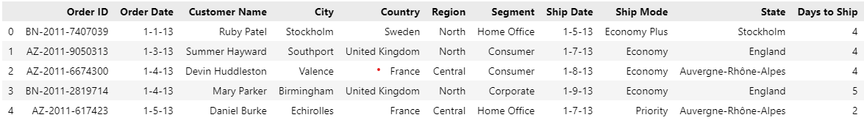
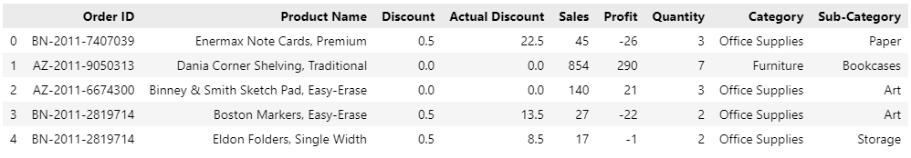
Data Exploration
Skill Academy
For this project, we have two datasets:
Order.tsv file: This dataset contains information about the orders placed at Amazing Mart. It includes details such as Order ID, Order Date, Ship Date, Customer Name, region, country, state, city, Segment, Ship Mode, and Days to Ship.
Order_breakdown.json: This dataset contains information about the breakdown of each order placed at Amazing Mart. It includes details such as Order ID, Product Name, Quantity, Discount, Actual Discount, Profit, Sales, Category, and Sub-Category.

Slide 4
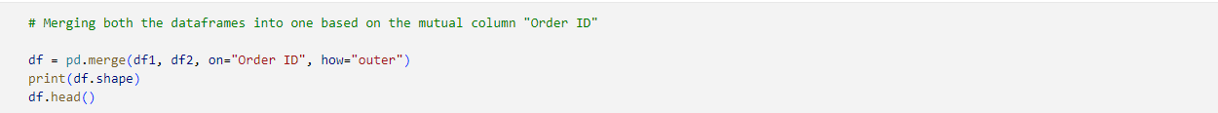
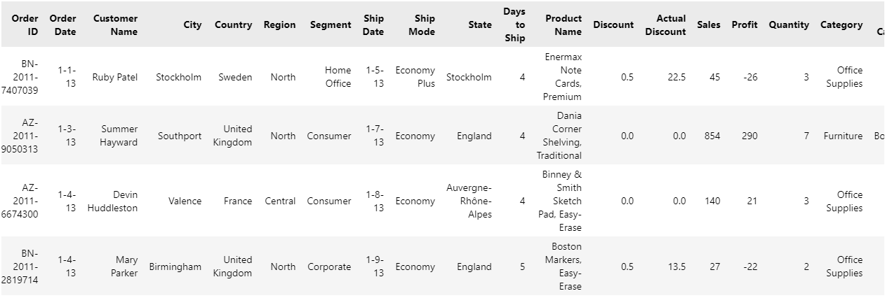
Data Insights
Skill Academy
We combined the Order.tsv file and Order_breakdown.json datasets based on the common Order ID column using the pandas library. This merged dataset now contains 8047 observations and 19 columns, combining information about both the order and the order breakdown details. This step helped us gain further insight into the data and allowed us to identify any relationships between the different variables. By merging the datasets, we were able to gain a more comprehensive understanding of the sales data for Amazing Mart and prepare it for further analysis.

Slide 5
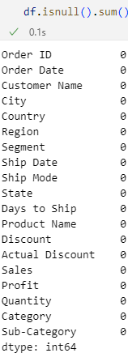

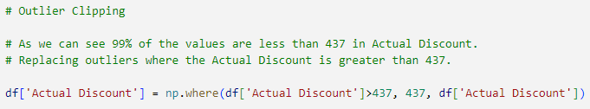
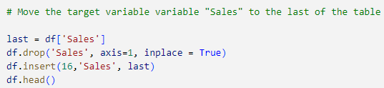
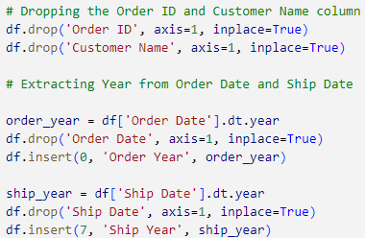
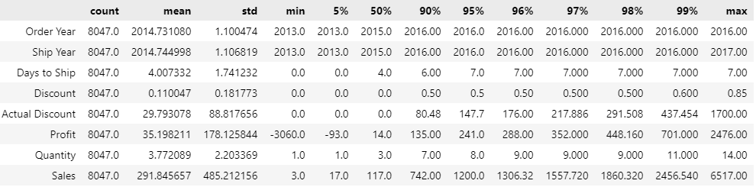
Data Cleaning
Skill Academy
In the Data Cleaning step, we prepared the merged dataset for analysis by performing several operations. We started by checking for missing values and found that there were none. Next, we converted the Order Date and Ship Date columns to datetime format for easier handling of date-related operations. We then dropped the Order ID and Customer Name columns, as they were not relevant to our analysis. We extracted the year from the Order Date and Ship Date columns, which will allow us to analyze sales trends over time. We also moved the target variable column to the last of the table for easier reference. Finally, we addressed any outliers in the Actual Discount column by clipping values above 437, which retained 99% of the values. These cleaning operations will allow us to perform more accurate analysis and modeling.

Slide 6
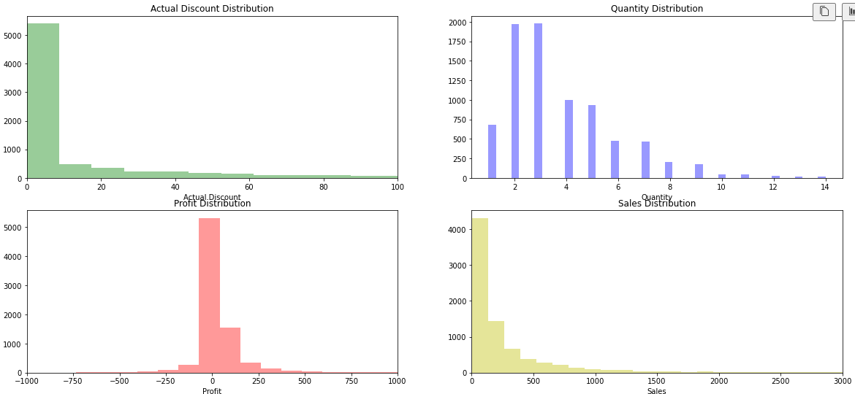
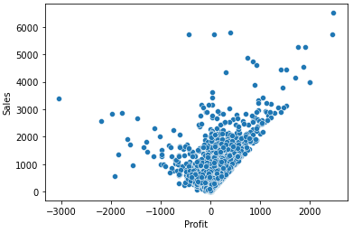
Exploratory Data Analysis
Skill Academy
In the Exploratory Data Analysis (EDA) step, we plotted various visualizations to gain further insights into the data. Firstly, we plotted the distribution of continuous columns and observed that the Actual Discount was mostly between 0 to 20, Quantity had the highest number of sales for 2 and 3, followed by 4 and 5, Profit had a huge spike at 0 and was mostly between -250 to 250, and Sales had a unimodal distribution with the largest spike between 0 to 500. The Actual Discount, Profit, and Sales had a unimodal distribution, while Quantity had a bimodal distribution. We also plotted a scatter plot which showed a positive association between Sales and Profit, indicating that as Sales increases, so does Profit.

Slide 7
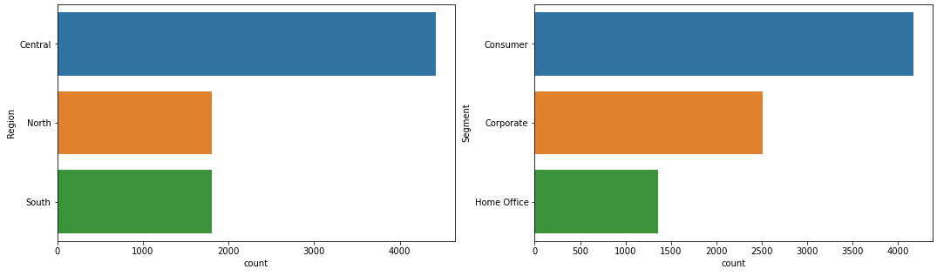
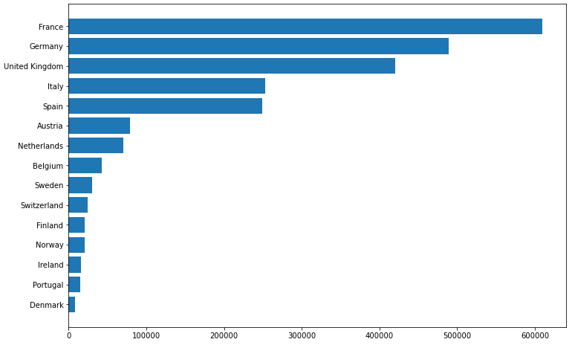
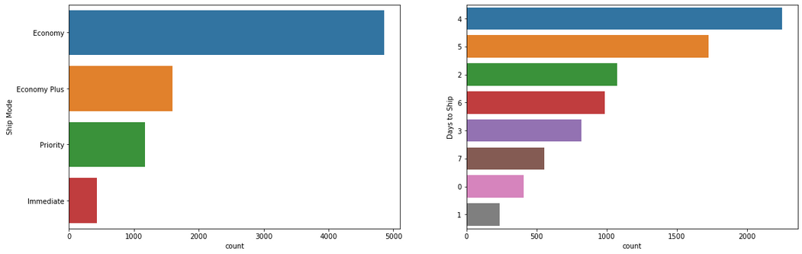
Exploratory Data Analysis
Skill Academy
Additionally, we counted the number of orders for different regions, segments, ship modes, and days to ship. We found that the Central region had the highest number of orders, while North and South regions had equal orders. Most of the orders were placed by consumers, followed by corporate clients. The Economy shipping mode earned the highest orders, followed by Economy Plus. The Immediate shipping mode had the lowest orders. Most of the orders were shipped in 4 or 5 days, and around 700 orders were shipped on the same day or the next day. We also plotted a country-wise sales plot and found that France recorded the highest sale, followed by Germany and the United Kingdom. Denmark, Portugal, and Ireland had very few sales. These insights give us a better understanding of the sales data for Amazing Mart and can be used to inform our modeling decisions.

Slide 8
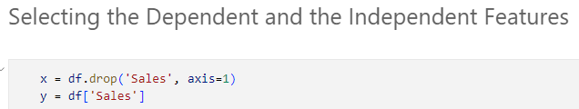
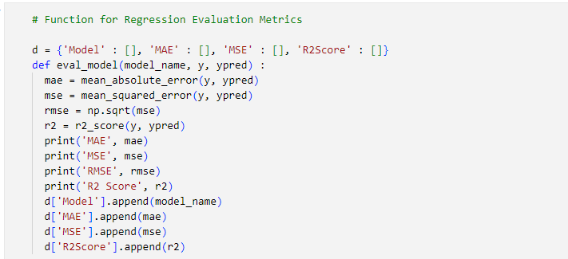
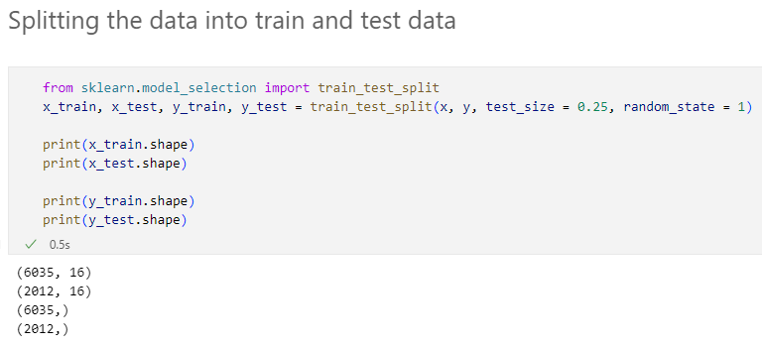
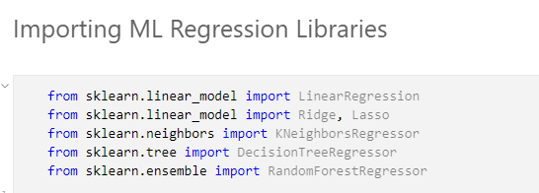
Model Building
Skill Academy
In the Model Building, we used 6 different regression algorithms to predict the Sales of Amazing Mart. These algorithms included Linear Regression, Ridge Regression, Lasso Regression, KNeighbors Regressor, Decision Tree Regressor, and Random Forest Regressor. To train these models, we selected the dependent and independent features and split the dataset into training and testing data. We then created a function to evaluate the models based on their Mean Absolute Error, Mean Squared Error, and R2 Score.

Slide 9
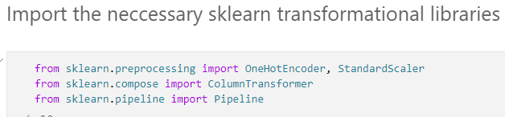
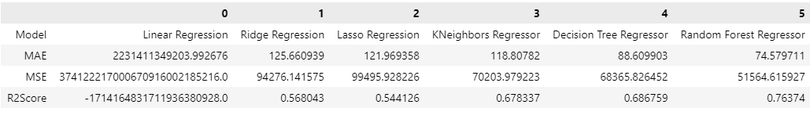
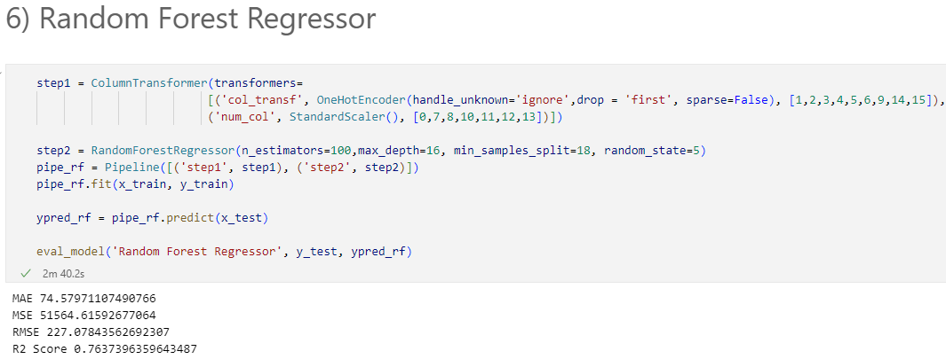
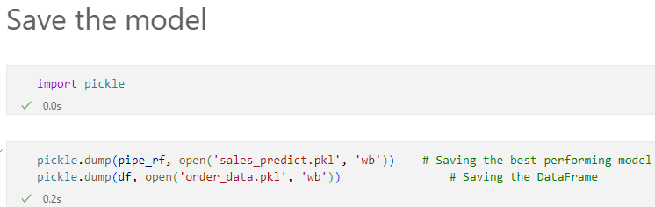
Model Building
Skill Academy
To further improve the performance of our models, we transformed the columns using OneHotEncoding, Standard Scaler and created a pipeline. After comparing the performance of all models, we concluded that the Random Forest Regressor was the best model with an R2 Score of over 76%. Finally, we saved this model as a binary file using the pickle library for future use.

Slide 10
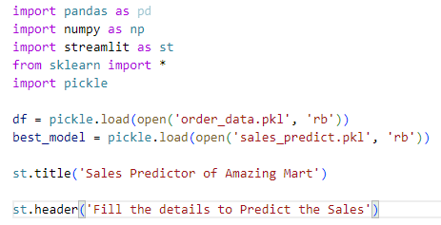
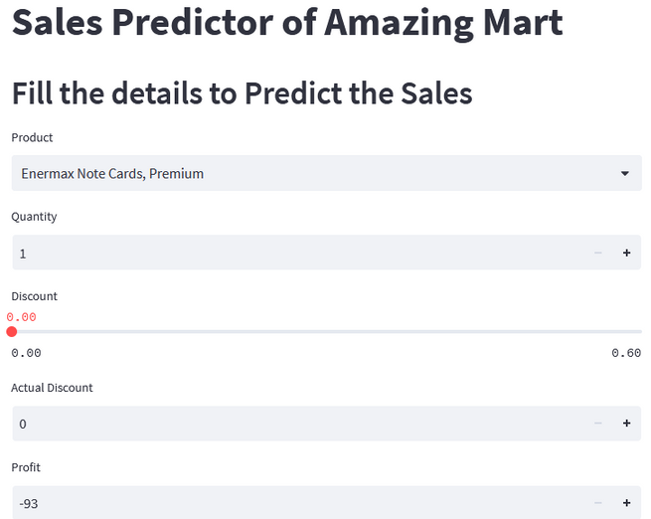
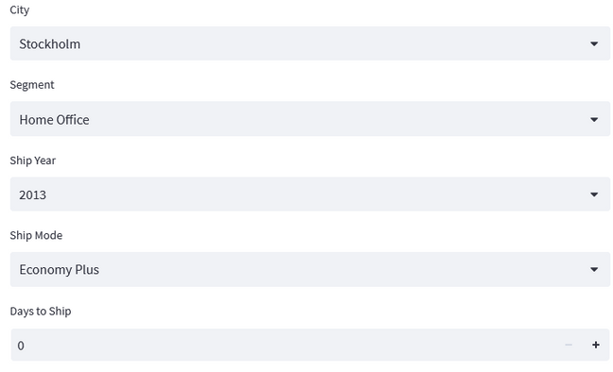
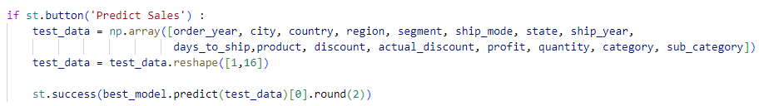
Deployment of ML Model
Skill Academy
In the final step of the project, we created a Streamlit app for predicting the sales of Amazing Mart. We utilized the Streamlit library to build an interactive and user-friendly application that could provide instant predictions based on the input data. The app was titled "Sales Predictor of Amazing Mart" and had a user-friendly interface that consisted of selectboxes for 11 columns: Product, Category, Sub-Category, Order Year, Region, Country, State , City, Segment, Ship Year, Ship Mode, and 4 number inputs for Quantity, Actual Discount, Profit, Days to Ship and a slider for Discount. After the user inputs the required data, a button was provided to generate the prediction of the Sales, which was calculated using the saved machine learning model from the previous step. This Streamlit app was an effective tool that allowed users to easily predict the sales and make informed decisions.

Slide 11

Conclusion
In conclusion, this project successfully demonstrated the application of machine learning algorithms for predicting the sales of Amazing Mart based on different features. We started with exploring and cleaning the data, followed by performing exploratory data analysis to gain insights into the dataset. Then we built and evaluated different regression models to predict sales and concluded that the Random Forest Regressor was the best model. Finally, we created an interactive Streamlit app that utilized the best model to generate predictions based on user inputs. This project highlights the importance of data analysis and modeling in making informed business decisions. By predicting sales, Amazing Mart can make better decisions regarding product promotions, inventory management, and sales strategies.

Slide 12

References
Tools used:- MS Excel, VSCode, Python, Numpy, Pandas, Matplotlib, Seaborn, Scikit Learn, Streamlit.
Git Hub:- https://github.com/Vipul-124/Amazing-Mart-Sales
Streamlit App:- https://vipul-124-amazing-mart-sales-app-sales-izrhab.streamlit.app/

